Slide 1
INTERACTIVE VIRTUAL AGENT FOR QUESTIONS RELATED TO COVID-19
Team 11
Charita
Krishna Prakash
Sree Lakshmi Sneha
Quoc Tuong Lukas Dong

Slide 2
Table of Contents
Objectives and Goals
Academic paper search engine for biostatisticians
Virtual Chatbot and its functionalities
Quick Overview of available features
Demo of chatbot
Drawbacks
Future work

Slide 3
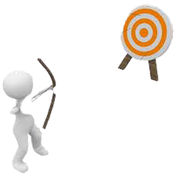

Goals and Objective of our Project
The main Goal of this project is to bring the scattered information into a single source
Where the employees of organization or students of an institution can access it with one click And have a real time conversation with the agent which provides an accurate information available around the web within seconds
Most of the Datasets are manually entered and it is hard to update the information which is changing on daily bases, so our objective is to connect the API directly to the Chatbot and the Search Engine

Slide 4
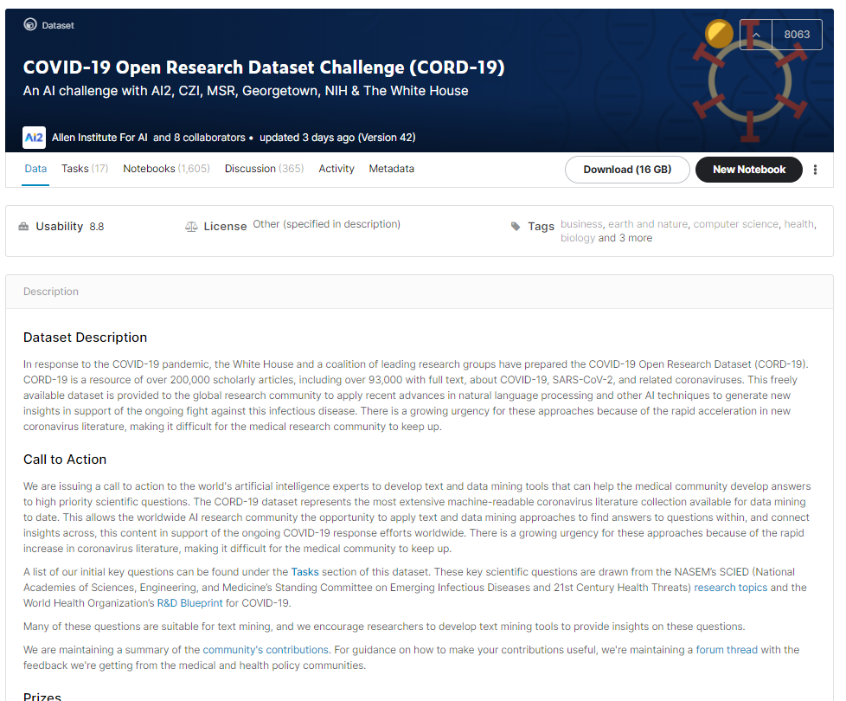
Academic paper search engine for Biostaticians

Slide 5
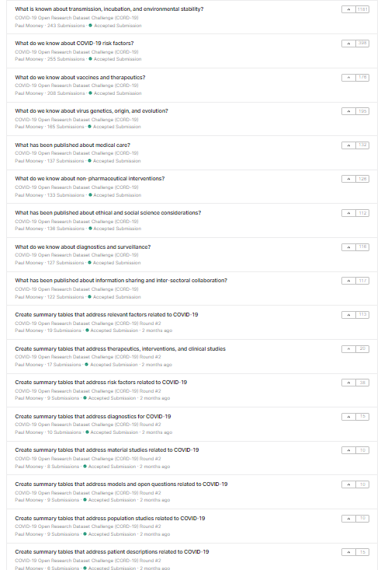
Population studies
Medical and Descriptions
Information about the virus (genetics, origin, evolution, etc.)
COVID Diagnostics
COVID Risks factors
COVID Vaccines and therapeutics

Slide 6
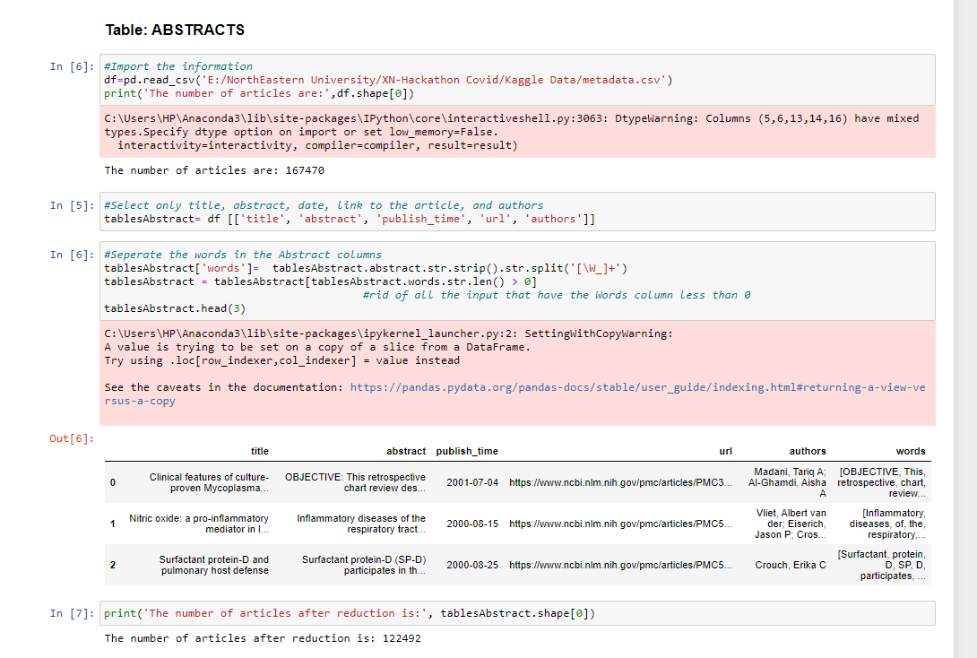

Slide 7
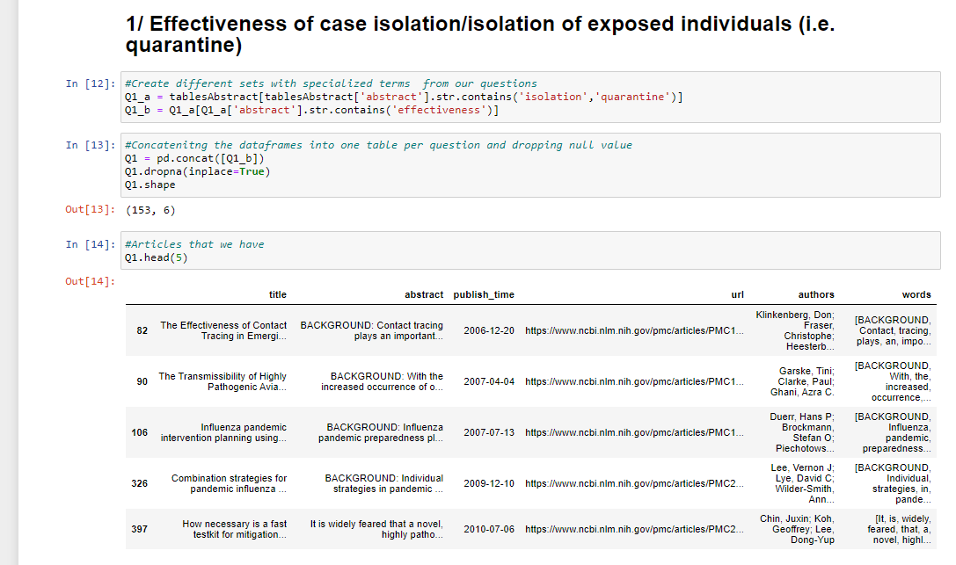

Slide 8
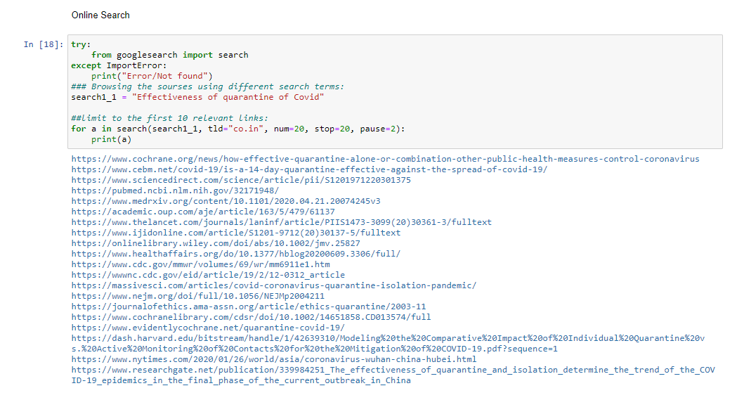

Slide 9
Quarantine effectiveness on exposed individuals?
153
The efficacy of novel therapeutics being tested currently?
9

Slide 10

What are the Functionalities of chatbot?
The General information about Covid-19 is available such as
Screening the symptoms of covid 19 for ourselves or others
What is Covid 19?
What are the Symptoms of covid-19?
How many confirmed cases are there in United States?
Chatbot is also build to respond to the users in 23 different languages
Also gives information about the worldwide confirmed, Death and Recovered patients count as it is going to be auto updated in real time
This chat bot can be integrated into different platform with respect to the requirement.

Slide 11
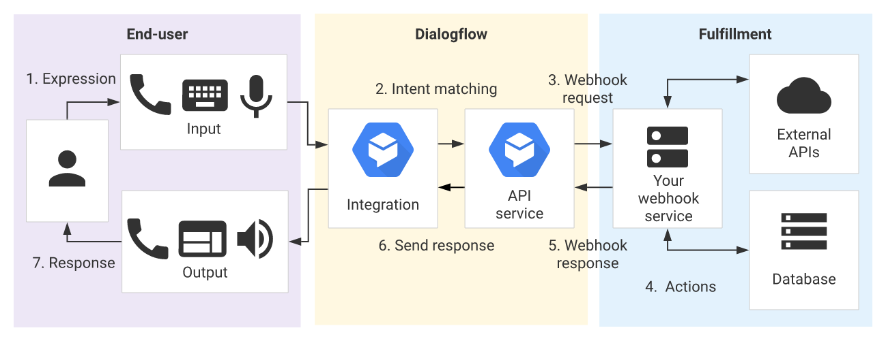
Chatbot Data Retrieval and Analysis
John Hopkins University, .gov Websites, WHO, CDC, Google Maps

Slide 12

Covid-19 Virtual Agent Demo

Slide 13










Quick Overview of some features
What is Covid 19?
Confirmed, Recovered, Deaths
Testing Locations
Cleaning & Sanitization
Do animals attract Covid
Mask for Children and Adults
Symptoms of Covid-19
Symptoms in Children
Indoor Quarantine
Medical Care
And many more features...

Slide 14
Future Recommendations for Project:
Academic papers search engine: implement effective NLP deep learning models using 4 different approaches for Text similarities (Text Pre-Processing, Feature Extraction, Vector Similarity, Decision Function)
Integrate academic papers search engine work to the chatbot
Build UI for messaging channels like Slack, Facebook, Telegram
Integrate an SQL or NoSQL database so the training data gets available for future training purposes

Slide 15

Thank you

